Slide 1
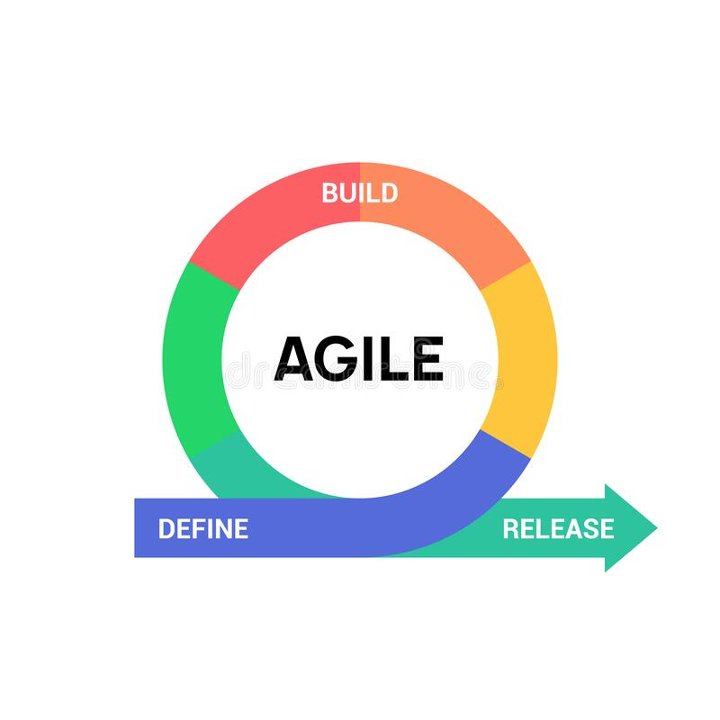

Slide 2
What is Agile?
Agile is an iterative approach to project management and software development that helps teams deliver value to their customers faster and with fewer headaches.
Instead of betting everything on a "big bang" launch, an agile team delivers work in small, but consumable, increments. Requirements, plans, and results are evaluated continuously so teams have a natural mechanism for responding to change quickly.

Slide 3
Agile Manifesto:
The Agile Manifesto emerged from this extended weekend at just 68 words, and the short and sweet document went on to change software development forever.
In the nearly two decades since its creation, these words (and the 12 principles that follow) have been embraced (in varying degrees) by countless individuals, teams, and companies.

Slide 4
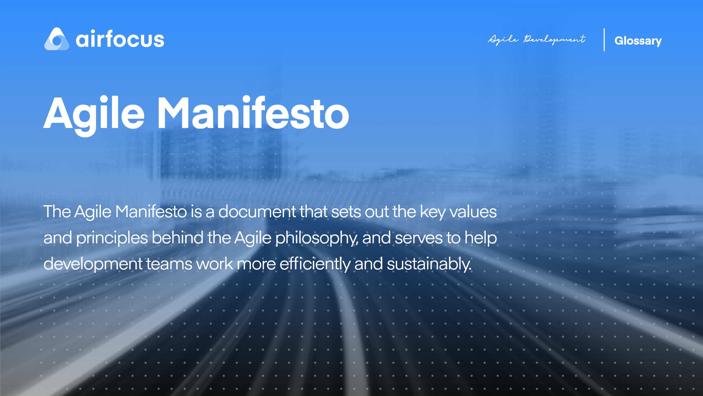

Slide 5
12 Agile Manifesto principles:
Our highest priority is to satisfy the customer through early and continuous delivery of valuable software.
Welcome changing requirements, even late in development. Agile processes harness change for the customer’s competitive advantage.
Deliver working software frequently, from a couple of weeks to a couple of months, with a preference to the shorter timescale.

Slide 6
Continue:
Face to Face Interactions.
Self-organizing teams can generate the most valuable software.
Business people and developers must work together daily throughout the project.
Build projects around motivated individuals. Give them the environment and support they need, and trust them to get the job done.

Slide 7
Continue:
The most efficient and effective method of conveying information to and within a development team is face-to-face conversation.
Working software is the primary measure of progress.
Agile processes promote sustainable development. The sponsors, developers, and users should be able to maintain a constant pace indefinitely.
Continuous attention to technical excellence and good design enhances agility.
The best architectures, requirements, and designs emerge from self-organizing teams.

Slide 8
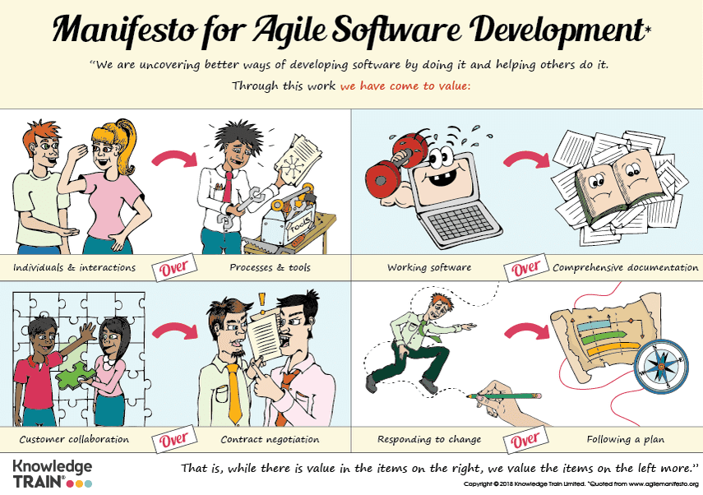

Slide 9
Agile Methodology:
The Agile methodology is a way to manage a project by breaking it up into several phases.
It involves constant collaboration with stakeholders and continuous improvement at every stage.
Once the work begins, teams cycle through a process of planning, executing, and evaluating.
Continuous collaboration is vital, both with team members and project stakeholders.

Slide 10
Agile methodologies overview:
The Agile Manifesto of Software Development put forth a groundbreaking mindset on delivering value and collaborating with customers when it was created in 2001.
Today’s agile landscape can seem cluttered with methodologies that promise to take agile ideals and turn them into real-world realities.

Slide 11
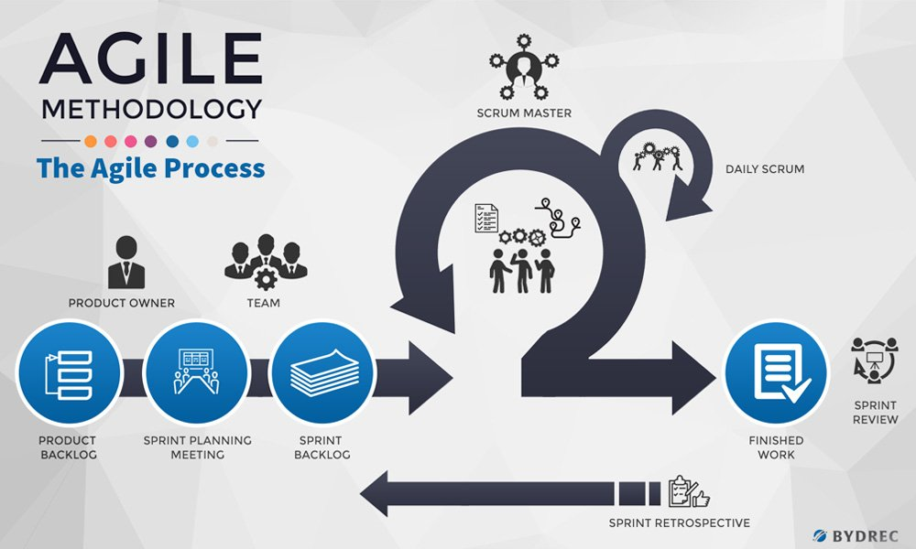

Slide 12
What is a product backlog?
A product backlog is a prioritized list of work for the development team that is derived from the roadmap and its requirements.
The most important items are shown at the top of the product backlog so the team knows what to deliver first
the development team pulls work from the product backlog as there is the capacity for it, either continually (kanban) or by iteration (scrum).

Slide 13
What are sprints?
A sprint is a short, time-boxed period when a scrum team works to complete a set amount of work.
Sprints are at the very heart of scrum and agile methodologies, and getting sprints right will help your agile team ship better software with fewer headaches.
"Sprints make projects more manageable, allow teams to ship high-quality work faster and more frequently, and give them more flexibility to adapt to change."

Slide 14
What is a scrum master?
The scrum master helps to facilitate scrum to the larger team by ensuring the scrum framework is followed. He/she is committed to the scrum values and practices, but should also remain flexible and open to opportunities for the team to improve their workflow.

Slide 15
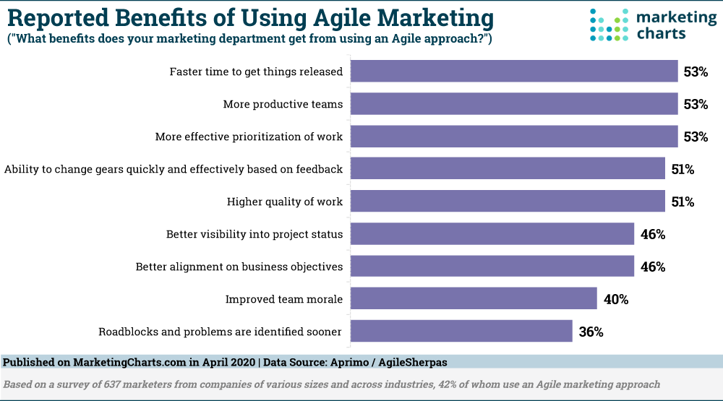

Slide 16
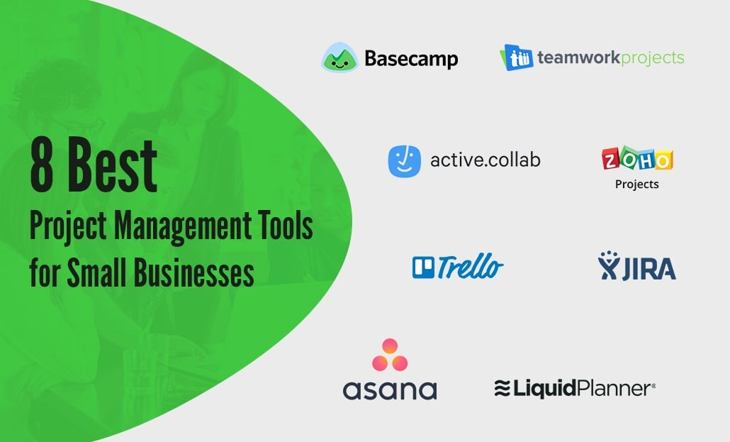

Slide 17
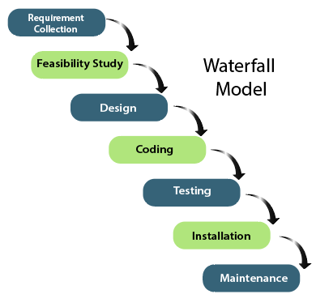
Waterfall Model:

Slide 18
Thank You!!!

